Slide 1

Metastasen der Wirbelsäule
Sebastian Hartmann
27.01.18

Slide 2
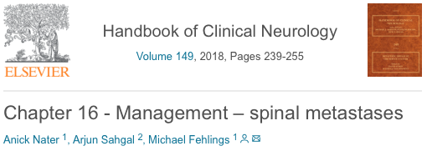
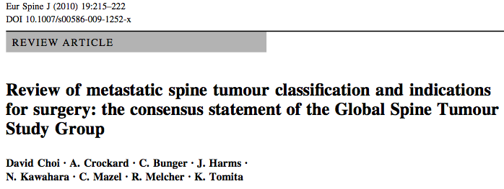
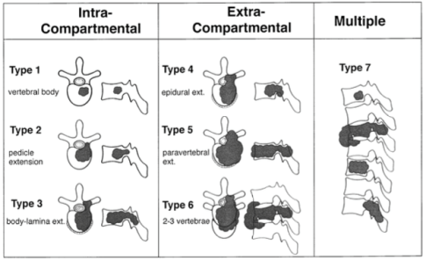
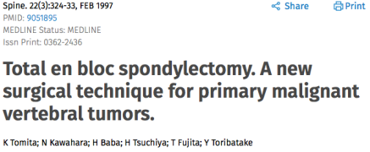
Introduction
Dramatically rise of symptomatic vertebral metastases
persistent in 30%-50% (70%)
metastases from breast, prostate, lung, colorectal and kidney tumours, sarcomas
thoracic spine is the region most commonly affected
    70% of all spine metastases (>LSpine> CSpine)
    Anterior part of the vertebra
    epidurally
symptomatic 4-7 Tomita et al. (according to GSTSG)

Slide 3
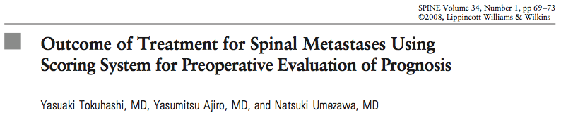
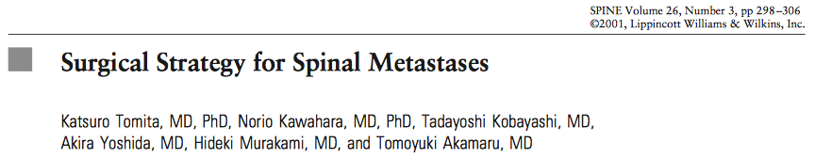
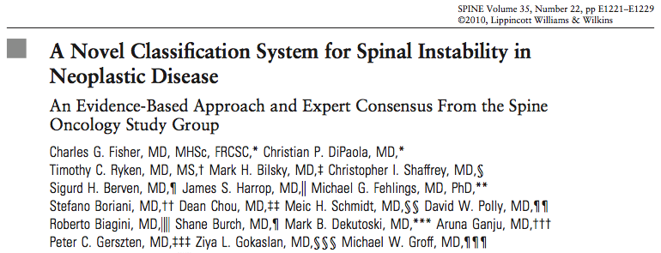
Decision-making in spinal metastases
Therapy controversial (different scoring systems)
Tokuhashi score/ Revised Tokuhashi score
Tomita score
SINS (Spinal Instability Neoplastic Score)
Predicted prognosis <90%
Prevent unnecessary surgical treatment
Individual situation of the patient
„...The most important point regarding the therapeutic strategy is to predict the survival period accurately before treatment...“

Slide 4
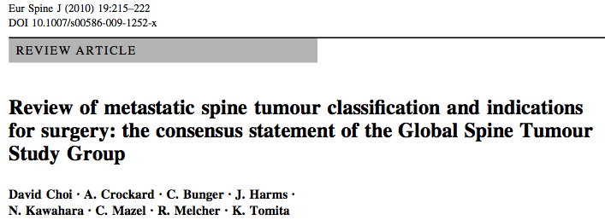
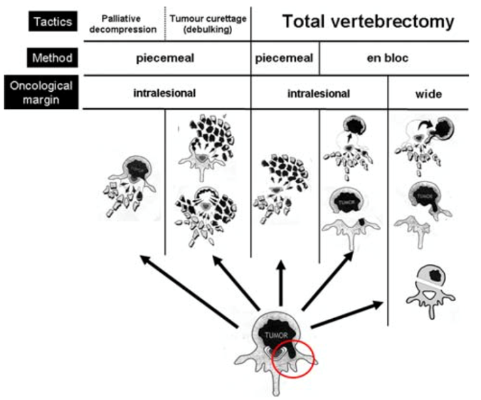

Operative treatment strategies
Decompressive surgery ± spinal Instrumentation (palliative surgery)
Debulking/ Tumour curettage (Marginal or intralesional excision or Wide or marginal excision)
En-Bloc- Resections (or „piecemeal“; 1 or more vertebrae)
  Evidence- level 4-5 => „Consensus statement“ GSTSG
Invasiveness

Slide 5



Surgical Therapie- Decompressive Surgery
Current evidence-based data
Decompressive surgery could be considered...
    <65 years
    lost motor function <48h
    Localised compression
    unknown histology
    estimated survival >3Mo
    poor prognostic factors for RT (spinal instability, bony compression, not RT sensitive)
postoperative RT immediately 2 weeks after surgery
optimal outcomes with decompressive surgery depend on RT (Rades 2011)
Low quality

Slide 6
Radiotherapy
RT primary treatment for ambulant and stable spines and for those who do not meet the criteria for decompressive surgery
short courses of RT with a predicted survival <6mo particularly ambulant and radio-sensitive tumours
non-ambulant patients 16% chance of regaining ambulation (single dose), 29% with short courses of RT
higher risk of local recurrence with short course RT
patients with good prognosis could be considered for longer course RT (8 fractions; 30 Gy).
<3Mo short course RT may be important
Optimum dose currently unknown
Current evidence-based data
RT primary treatment for ambulant and stable spine (who do not meet the criteria for decompressive surgery)
Short course RT (1 to 2 fractions; 8-16Gy) <6Mo (important <3Mo, high recurrence risk)
Long course RT (8 fractions; 30 Gy) >12Mo
Optimum Dose currently unknown
Low- to moderate quality

Slide 7

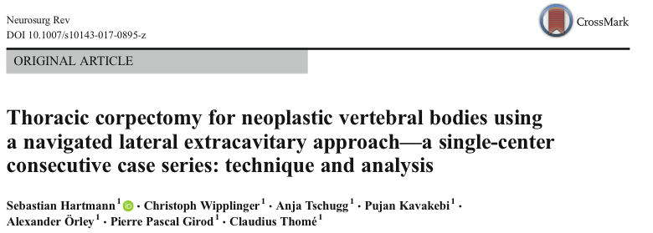
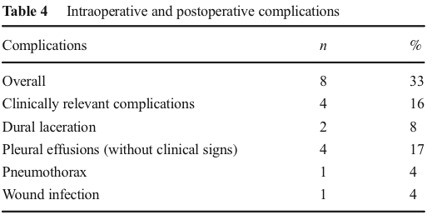
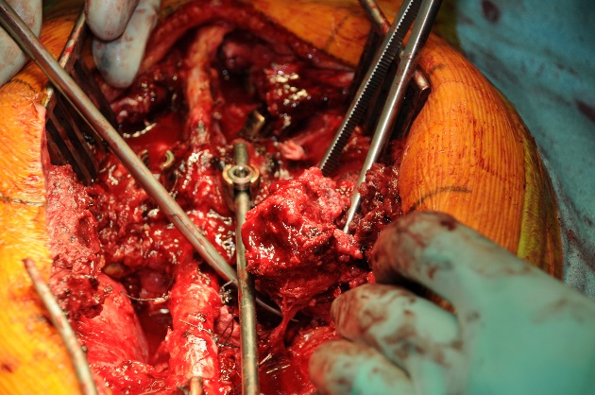
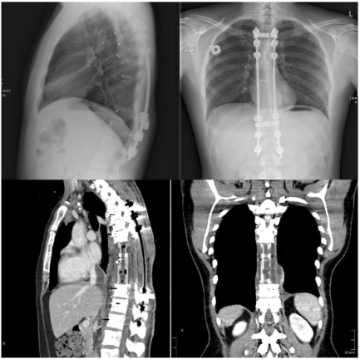
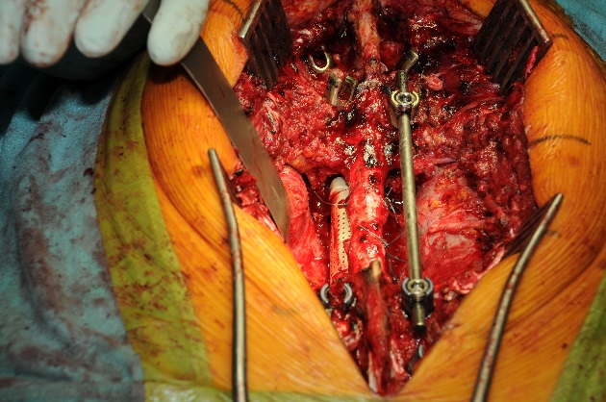
Surgical complications
2.8% hardware complications
78% mortality rate (during the 7-year study period)
Risk factors:
  Chest wall resections (p<.05)
  construct length greater than six contiguous levels (p<.05)
  Female gender (trend)

Slide 8
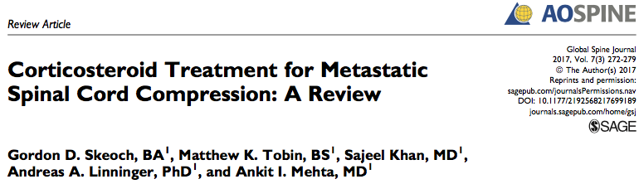

M(E)SCC and Dexamethasone
Current evidence-based data
Animal studies => significant improvements of symptoms
Human clinical studies => no significant effect of dexamethasone
A high frequency of adverse side effects linked to high-dose steroid treatment
Low dose => low effect
High dose => high SAE

Slide 9
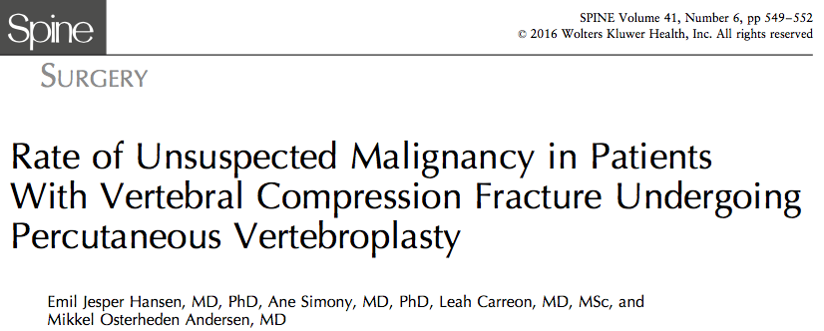

Vertebral body fracture and malignancy
4.9%

Slide 10
Conclusion
30-50% of tumor patients suffer from spinal metastases
Thoracic spine, anterior vertebral body, epidural infiltration
Score patients (Tokuhashi, Tomita, SINS)
Evidence-level of treatment = 4-5, except for decompressive surgery (LE) (low-quality Cochrane Review/MetaAnalysis)
LECA = > acceptable short outcome (EBM- en-bloc >20% complication rate)
RT primary therapy => no neurology and stable spine => longer life expectancy = long course RT (8 fractions/ 30Gy)
Dexamethasone => no benefit
Vertebral body fracture => Biopsy => 4.9% neoplastic infiltration
GSTSG Recommendations...
Tokuhashi/Tomita Score
Risik and Benefit evaluation
Speak with patient (QoL, NRS, prognosis)
En bloc => single meta+good prognosis

Slide 11
„Good surgeons know how to operate, better surgeons know when to operate, and the best surgeons know when not to operate“

